Slide 1



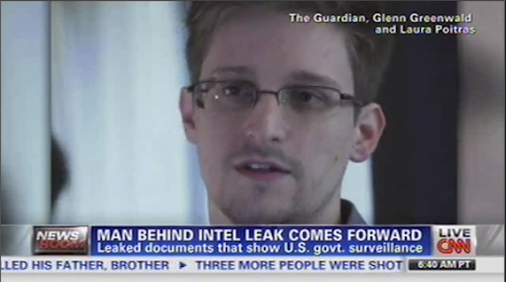
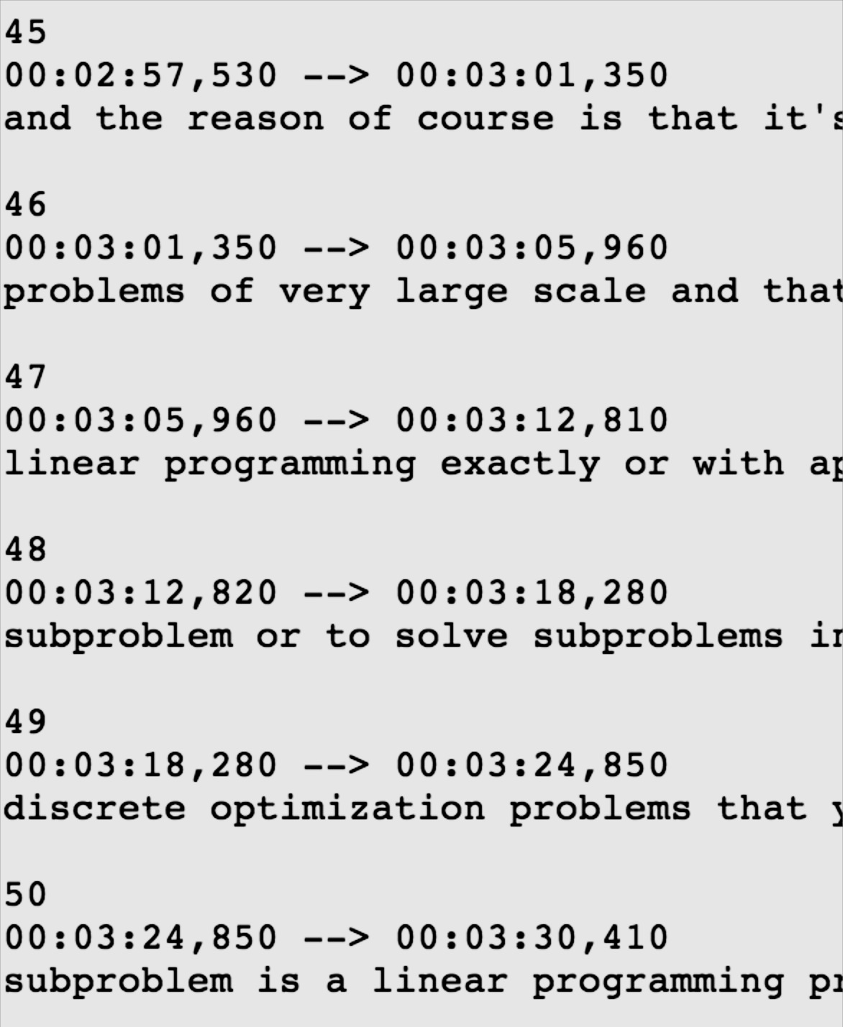



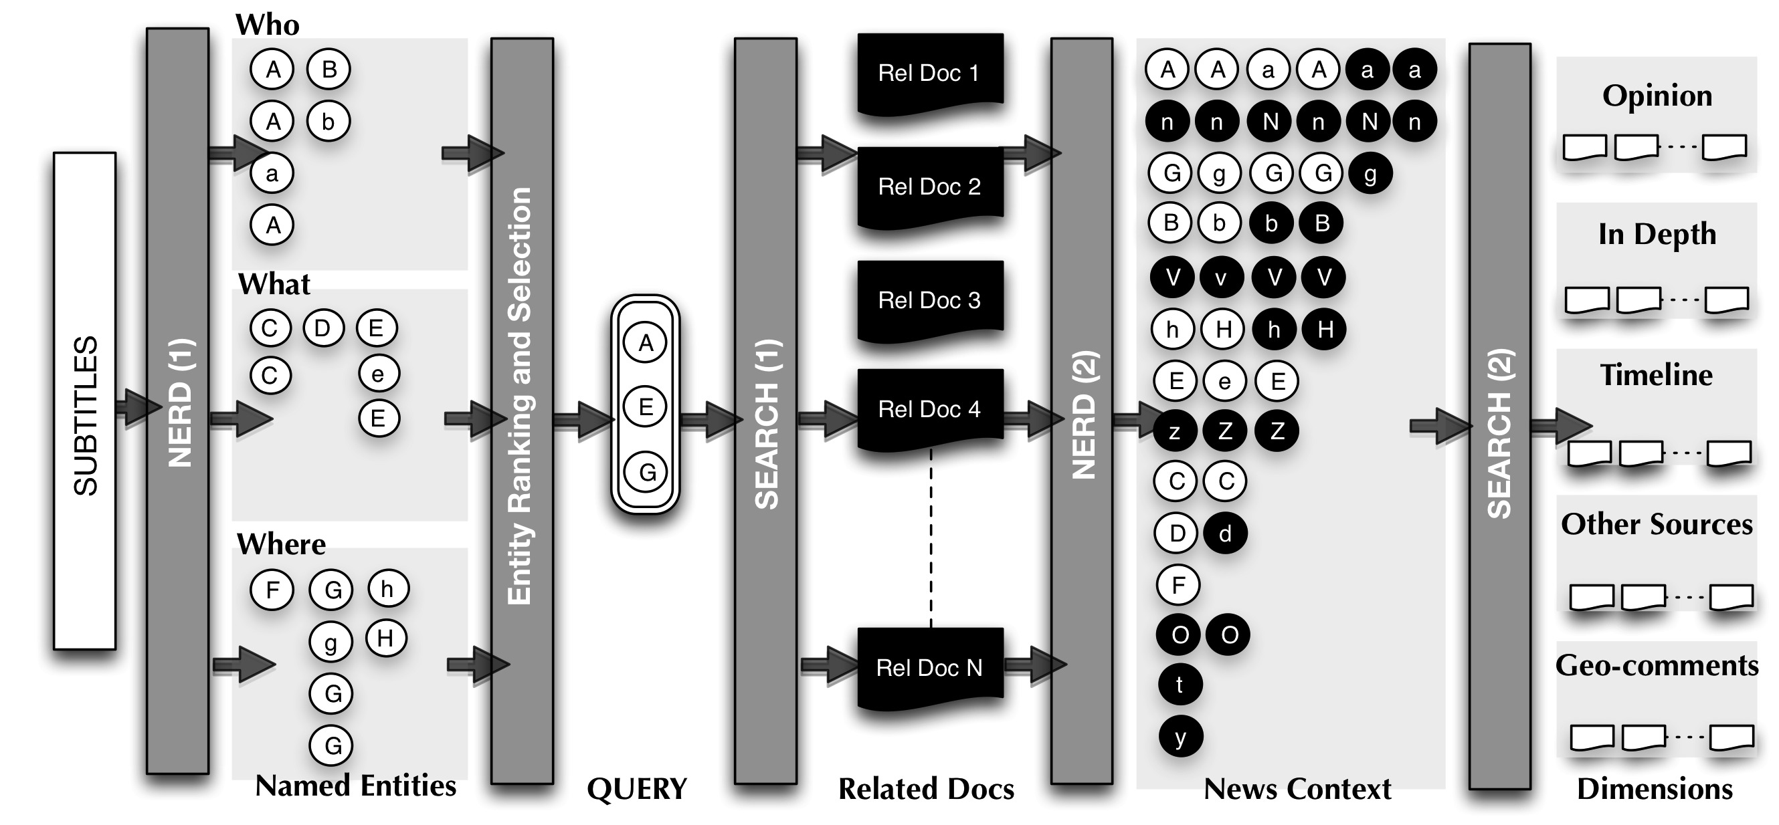
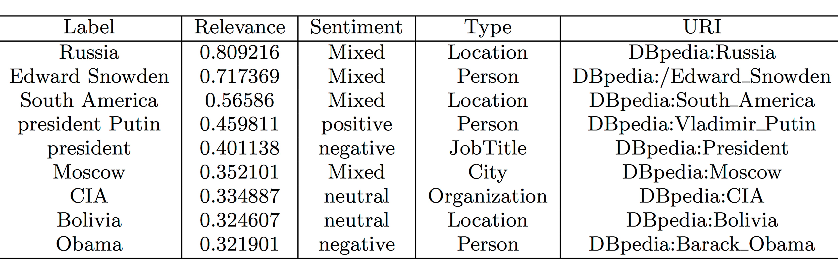
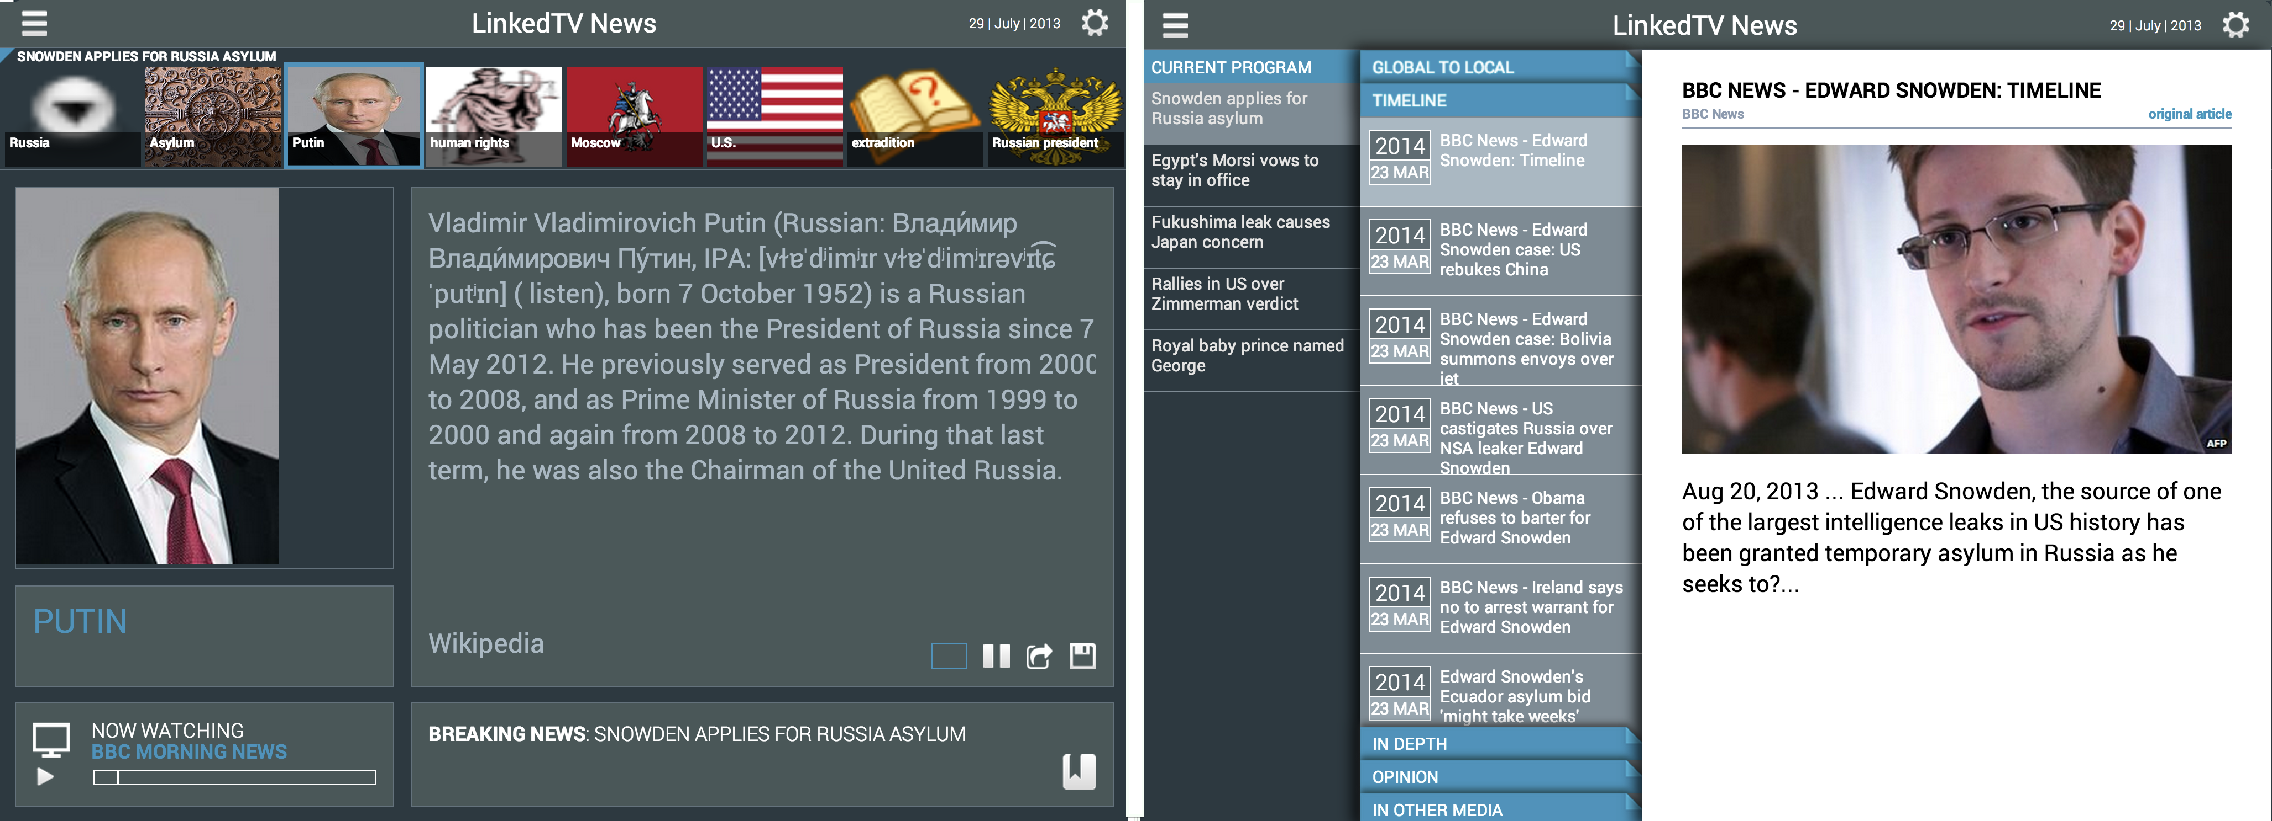
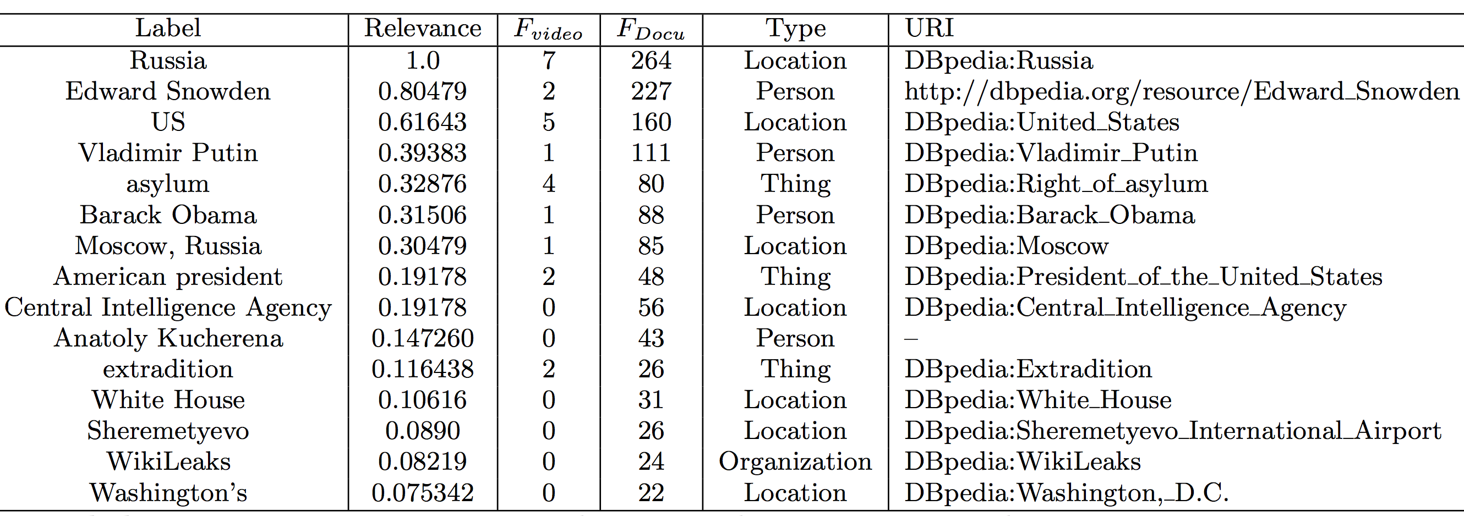
Augmenting TV Newscasts via
Entity Expansion
José Luis Redondo García, Raphaël Troncy
{redondo, raphael.troncy}@eurecom.fr
The problem: Annotating Newscasts
News Entity Context
a) Entities from Video
e_{a}
e_{b}
e_{c}
e_{d}
(1) Document Expansion
Subtitles
Metadata
OCR
Visual Cues
b) Expanded
Entities
e_{a}
e_{b}
e_{c}
e_{d}
e_{f}
e_{g}
e_{h}
e_{i}
e_{j}
e_{k}
e_{l}
e_{m}
LSCOM:Face
LSCOM:Building
LSCOM:Animal
(2) Clustering, Filtering and Ranking
In which Russian airport is he giving the interview?
c) Re-ranked Entities
e_{a}
e_{c}
e_{h}
e_{j}
e_{k}
e_{m}
Relevancy
Representativeness
The Approach: Named Entity Expansion
Results: Edward Snowden Asylum
Feeding Television Application
Feeding TV Application
➔
Named Entity Expansion
➔
➔
➔
✚




✚
✚
Passive Mode
Slide show
Active Mode
5 Dimensions Enrichment
✚
✚
✚
✚
References
[1] Y. Li, G. Rizzo, J. L. R. García, R. Troncy, M. Wald, and G. Wills. Enriching Media Fragments with Named Entities for Video Classification. In 1st Worldwide Web Workshop on Linked Media (LiME’13), pages 469–476, Rio de Janeiro, Brazil, 2013.
[2] J. L. R. García, M. Hildebrand, L. Perez Romero and R. Troncy. Augmenting TV Newscasts via Entity Expansion. In Demonstration Track of Extended Semantic Web Conference (ESWC), Crete, Greece, May 2014
Notes:
Base pour concevoir votre poster EURECOM.
Le service COM est à votre disposition pour toute aide complémentaire

